Slide 1
Cellular Respiration Overview
1st phase: Glycolysis
  Breaks glucose into 2 pyruvate molecules
  2 ATP produced
  2 NADH produced
2nd phase: Pyruvate Oxidation
  Pyruvate is oxidized, bonds with Coenzyme A
  Forms Acetyl-CoA
3rd phase: Citric Acid Cycle (CAC)
  Breaks 2 Acetyl-CoA (from the pyruvate molecules)
  Produces CO₂
  2 ATP produced
  6 NADH, 2 FADH₂ produced
4th phase: Oxidative Phosphorylation
  Electron Transport Chain (ETC)
  Chemiosmosis
  Produces lots of ATP

Slide 2
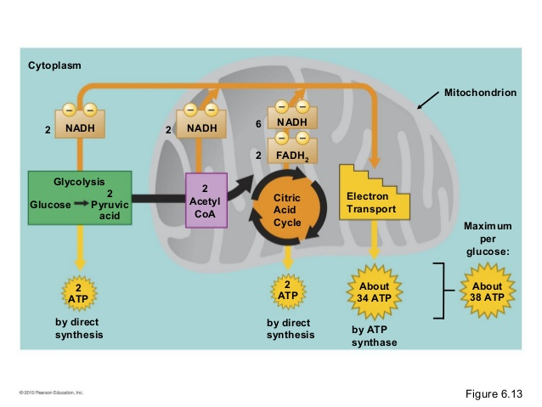

Slide 3
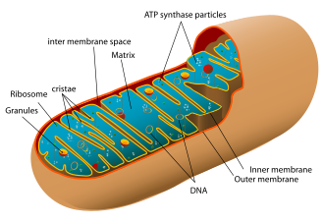
Oxidative Phosphorylation
Combination of two processes:
  Electron Transport Chain (ETC)
    Where: Mitochondrial inner membrane
    Who is the main player: NADH and FADH₂
  Chemiosmosis
    Where: Mitochondrial intermembrane space
    Who is the main player: H+ ions

Slide 4
Oxidative Phosphorylation
When: We learn about this as the last phase but it happens any time NADH and/or FADH₂ are produced
What goes in (per molecule of glucose):
  10 NADH from glycolysis (2), pyruvate ox (2), CAC (6)
  2 FADH₂ from CAC
  O₂ (from breathing)
What comes out:
  26-28 ATP
    This number can vary slightly depending on the type of cell.
  Water

Slide 5
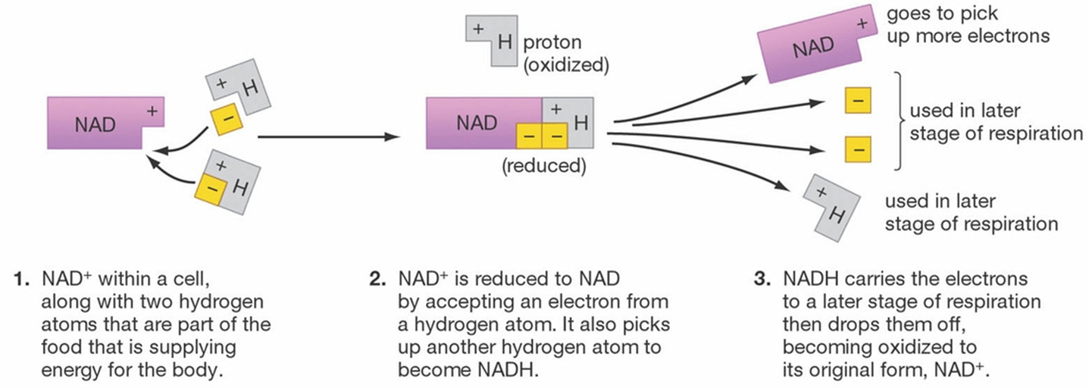
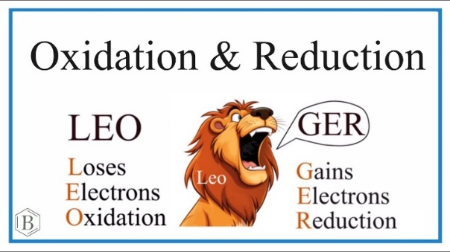
Electron Transport Chain (ETC) Overview
In Prokaryotes, takes place in the plasma membrane
In Eukaryotes, takes place in the mitochondrial inner membrane
Electron Protein Complexes embedded in the mitochondrial inner membrane take electrons stored in NADH and FADH₂ and pass them from one complex to another, down the chain to lower energy levels

Slide 6
Electron Transport Chain (ETC)
Electron Protein Complexes:
  4 large complexes
    I - IV
  2 smaller shuttles
    Ubiquinone (Q)
    Cytochrome C (Cyt c)
NADH deposits electrons at complex I
FADH₂ deposits electrons at complex II
  Downstream from complex 1

Slide 7
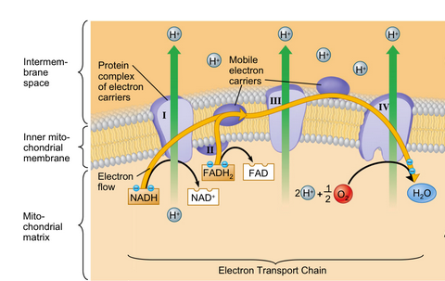

Slide 8
Electron Transport Chain (ETC)
Electrons “fall” from one electron carrier to another, each giving off a bit of free energy
  This energy is used to pump H+ ions from the matrix into the intermembrane space
  Against the concentration gradient
    More H+ in the intermembrane space than in the matrix

Slide 9
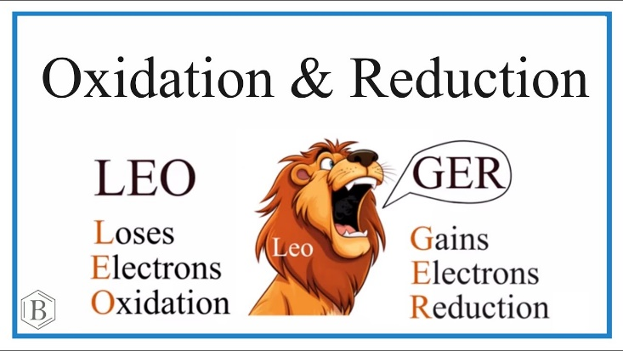
Electron Transport Chain (ETC)
Each electron carrier complex bounces back and forth between being reduced (when it accepts an electron) and being oxidized (when it loses an electron)
The final electron acceptor is oxygen
  Bonds with two hydrogens to form water

Slide 10
Electron Transport Chain (ETC)
Remember the overall goal of these processes is to form energy (ATP!)
The electrons moving through the protein complexes allows for active transport that supports the final step!

Slide 11
Chemiosmosis
H+ concentration gradient
  More H⁺ in intermembrane space (out) than in matrix
  This gradient serves as energy source
  This energy source drives ATP production
ATP Synthase is the enzyme that makes ATP
  H⁺ flow down the concentration gradient from the intermembrane space through ATP Synthase into the matrix
    This downhill flow provides the energy to make ATP from ADP
      Oxidative Phosphorylation

Slide 12
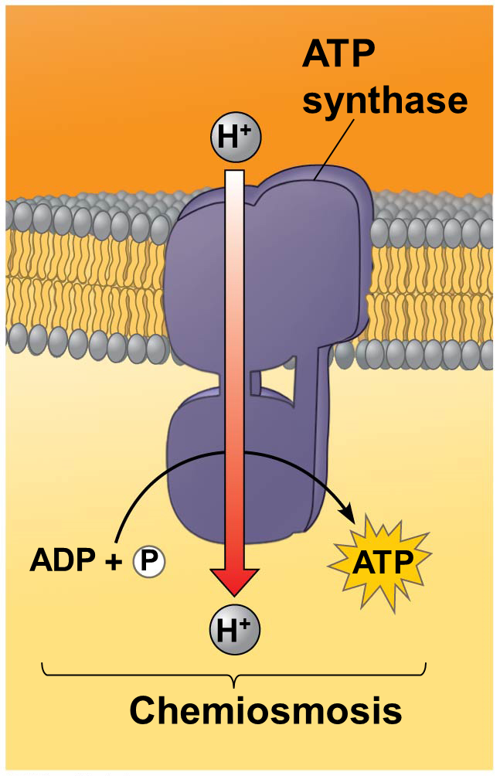
Intermembrane Space
(High H+)
Mitochondrial Matrix
(low H+)

Slide 13
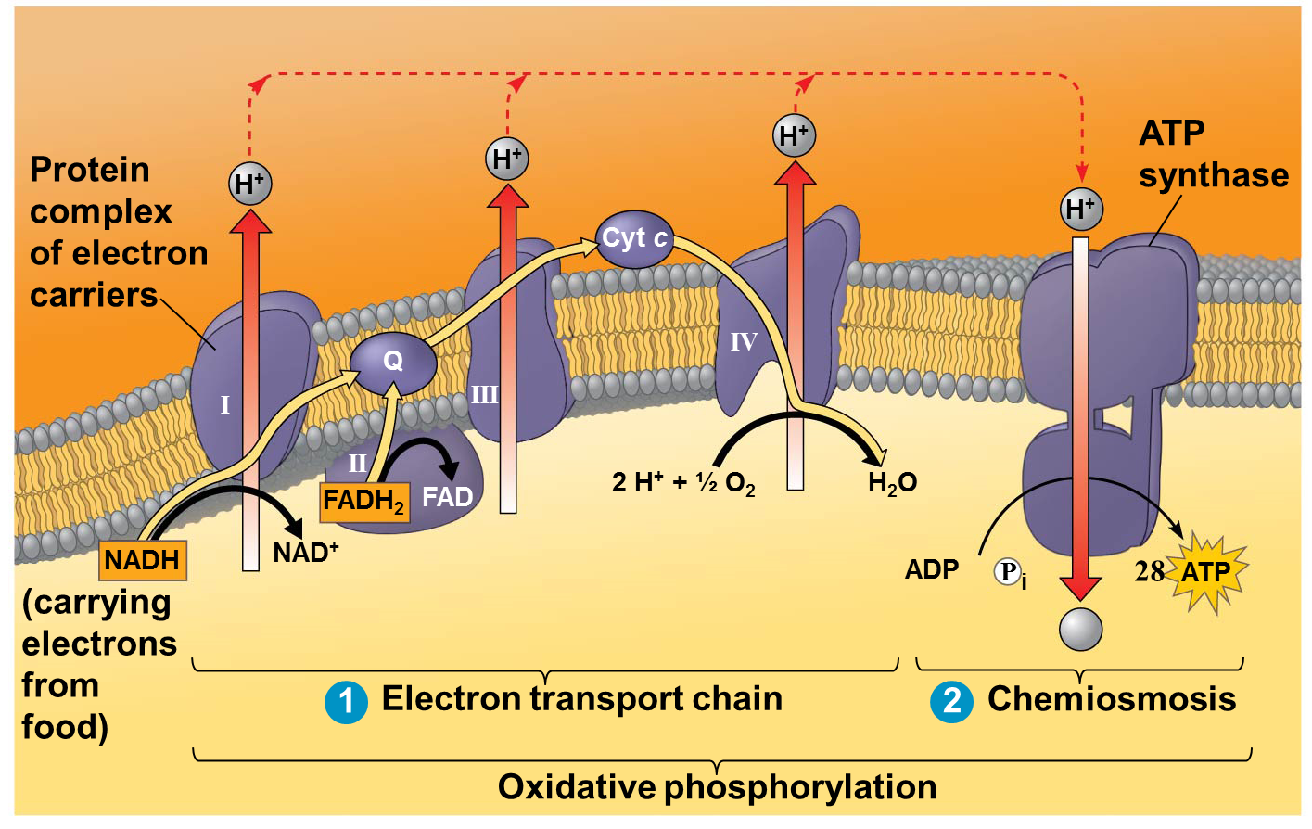
ETC + Chemiosmosis = Oxidative Phosphorylation
26-28

Slide 14
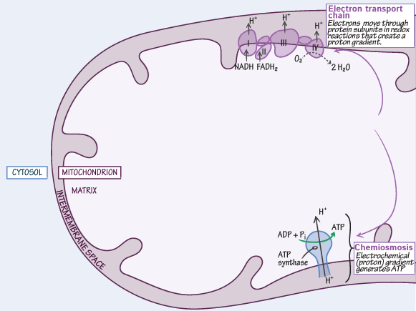

Slide 15
What about other food sources?
Free glucose is not abundant in most diets
Carbohydrates are hydrolyzed to glucose
Proteins must be hydrolyzed to amino acids
  Amino group removed
  Carbon backbone enters glycolysis or CAC
Lipids are hydrolyzed to glycerol or fatty acids
  Glycerol enters middle of glycolysis as G3P
  Fatty acids are converted to Acetyl-CoA and enter CAC

Slide 16
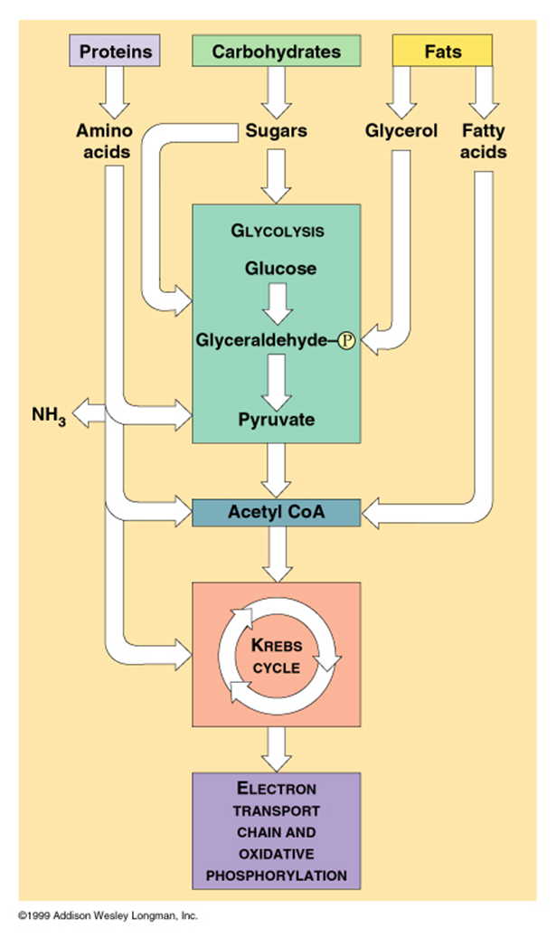

Slide 17
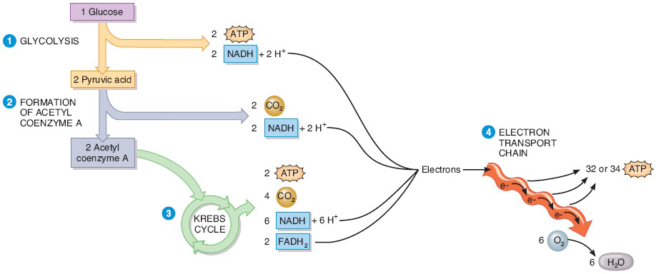
Cell Respiration Overview
26-28

Slide 18
Cellular Respiration Video
Cellular Respiration Video

Slide 19
Fermentation
Two types:
  Alcohol fermentation
    Pyruvate converted to ethanol
  Lactic acid fermentation
    Pyruvate converted to lactate
Happens after Glycolysis
Only makes 2 ATP (less efficient)
Cycle repeats
  No progression to CAC or Oxidative Phosphorylation

Slide 20
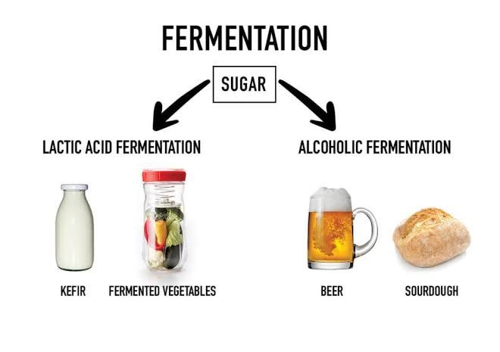

Slide 21
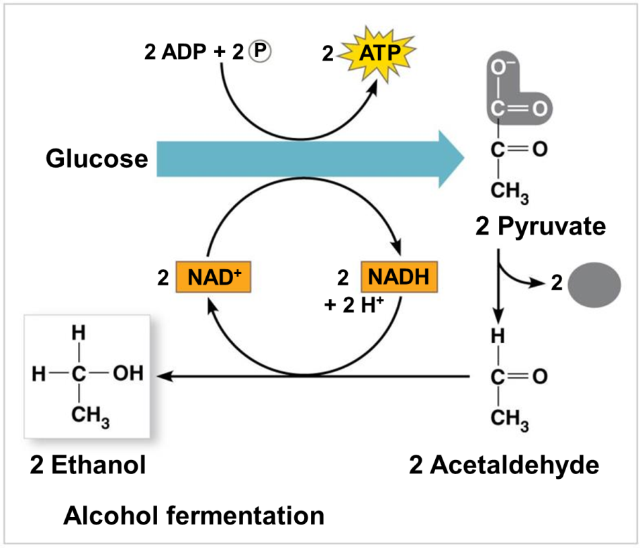
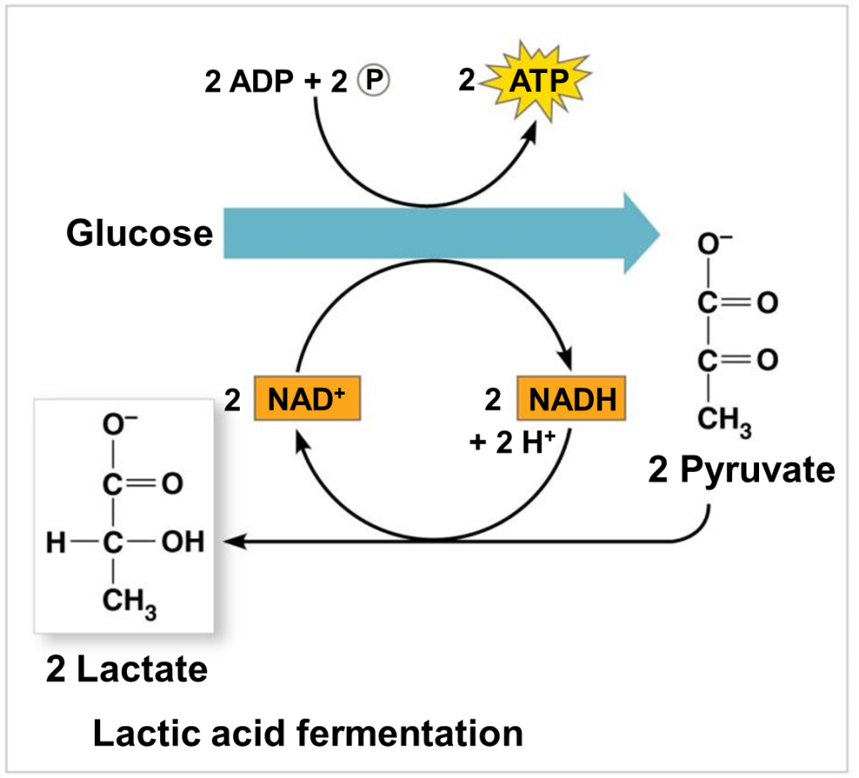

Slide 22
Cellular Poisons
Some poisons interrupt/block one or more stages of Cellular Respiration
  Electron Transport Chain
    Rotenone
      Disrupts Complex I to Ubiquinone
    Cyanide
      Disrupts Cytochrome C complex
    Carbon monoxide
      Prevents O₂ from being final electron acceptor
  Chemiosmosis
    Oligomycin
      Blocks ATP Synthase
    DNP
      Allows H+ to leak back into matrix

